Slide 1
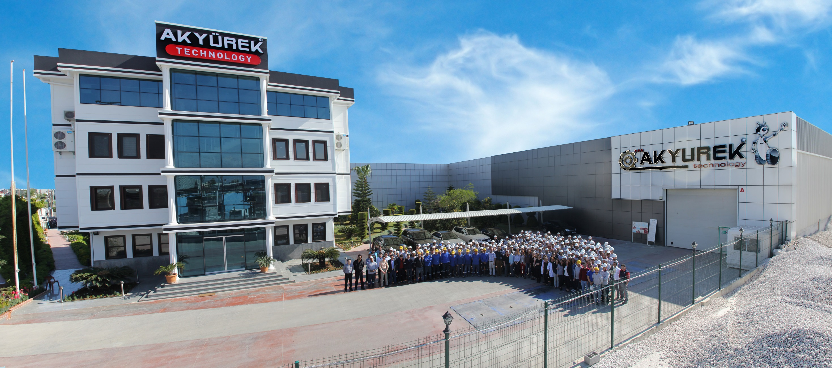
AKYUREK Machine Joint Stock Company

Slide 2
Ali Tugbay TAVUKCU Akyurek Technology International Sales & Project Coordinator Company Name: AKYUREK MAKINA SANAYI ve TICARET A.S. Address: No:37 65117 Street Karaduvar Avenue | City :Mersin | Post Code: 33020 | Country: Turkey Website: akyurekltd.com Mobile Phone : +90 530 342 45 03 WhatsApp /Viber Office Telephone: +90 444 62 59| Fax: +90 324 234 47 07 E-mail : atugbay@akyurekltd.com Online Chat/talk | Skype : ali.tugbay.tavukcu

Slide 3
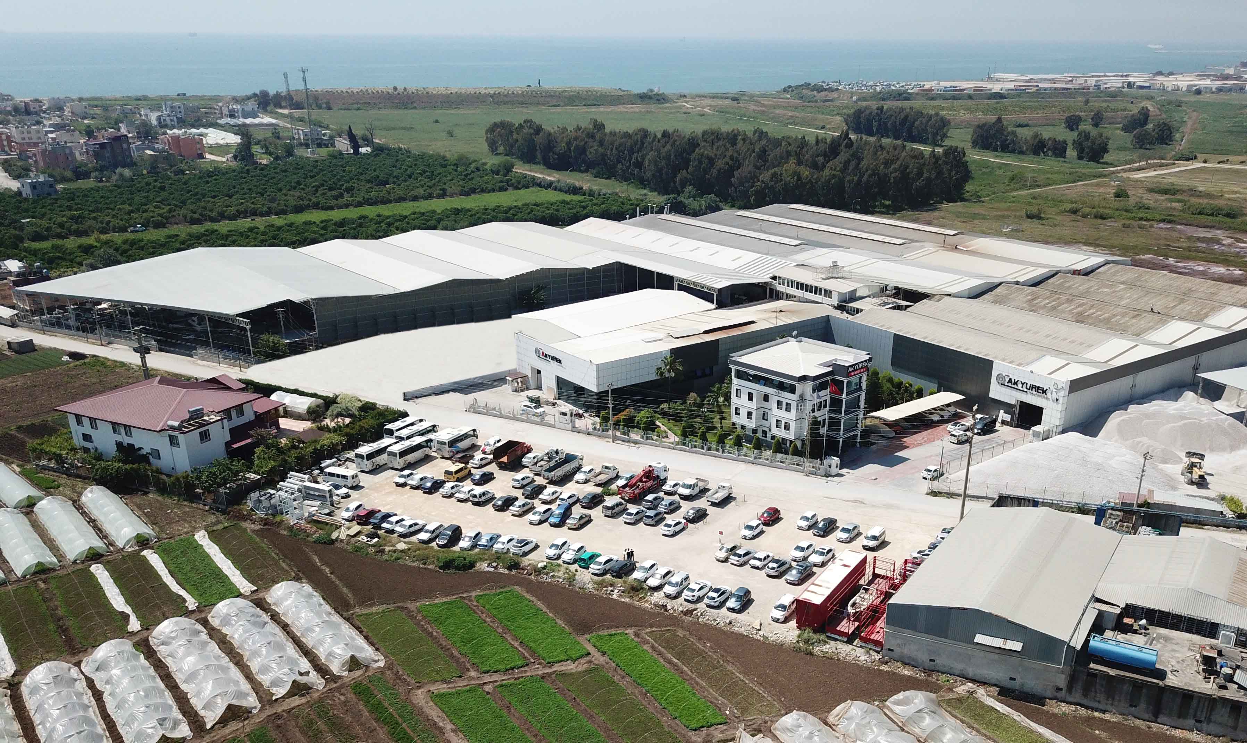
42.000 Meter Square Production Facility and Head Office

Slide 7
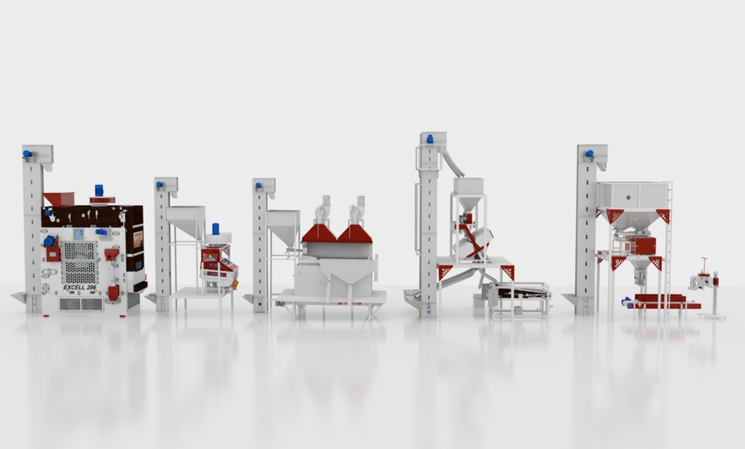

Slide 10
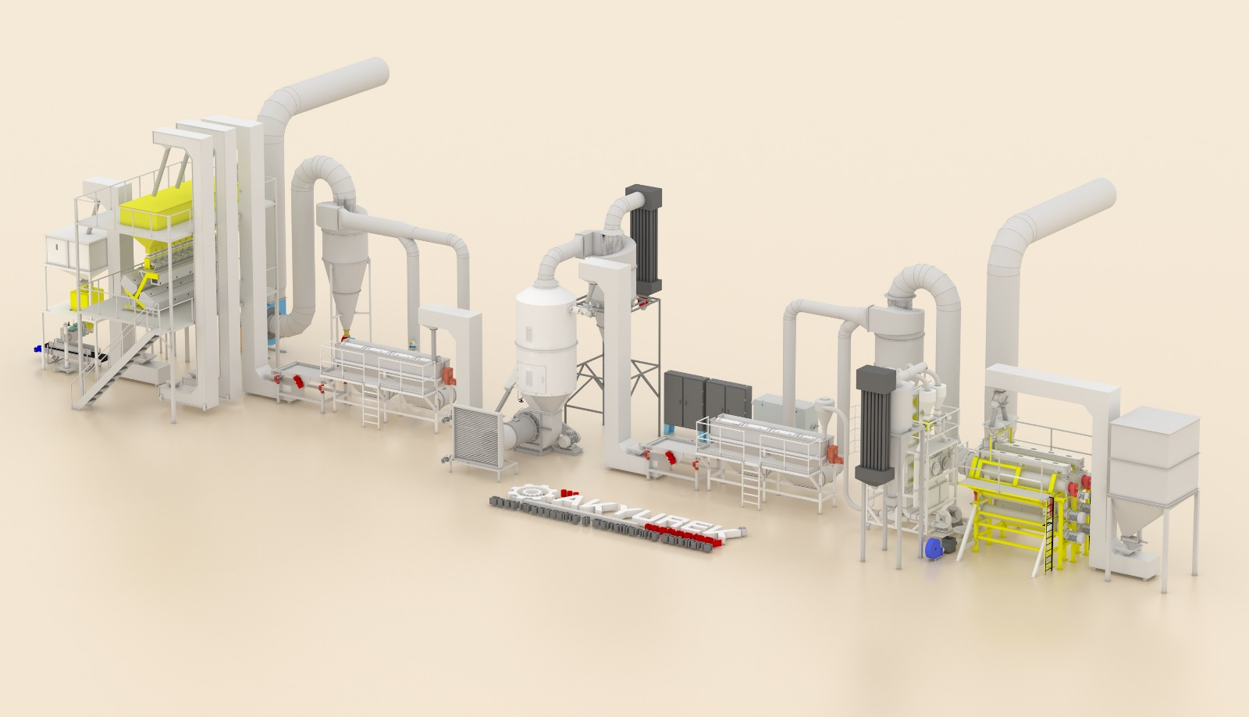
1 tph Sesame Peeling line
Render Visual

Slide 11
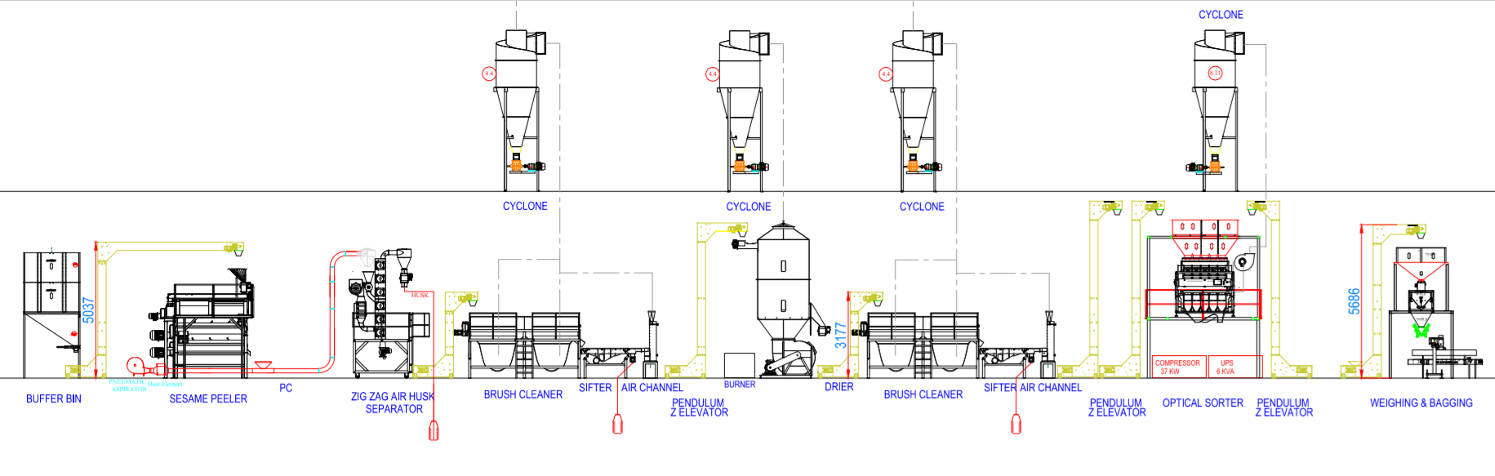
Section View & Diagram

Slide 12
Topview-Layout
40 x 11 Meters – H: 7 meters

Slide 13
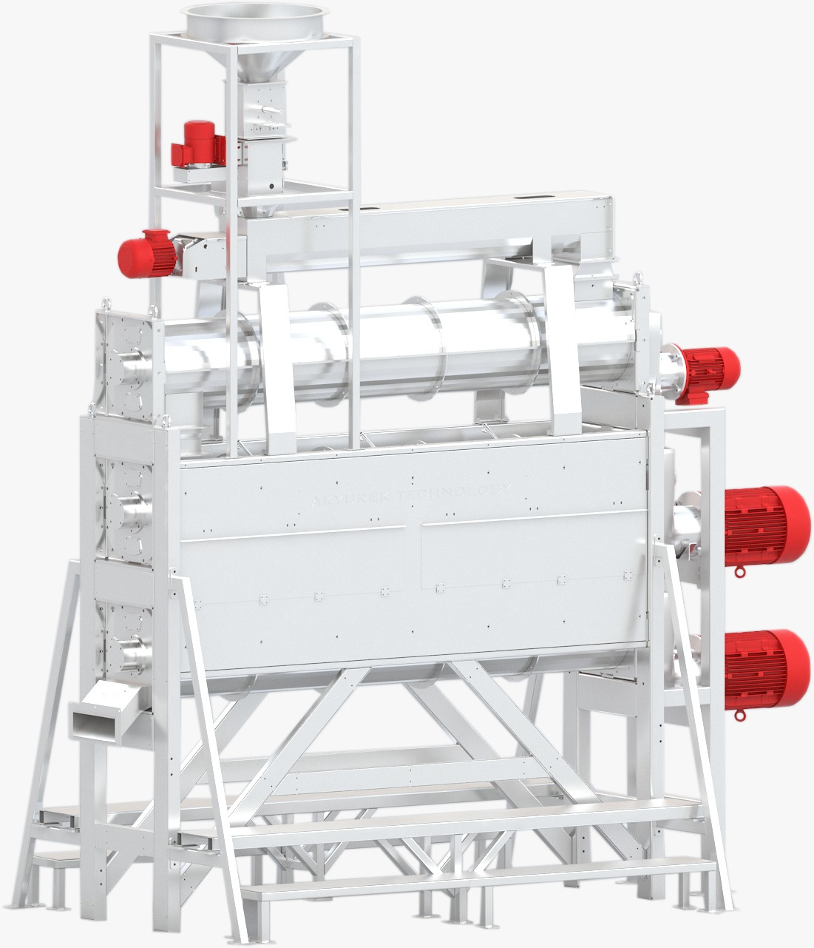
SESAME PEELER
Akyurek's Sesame Peeler SP-4000 Series is a precise and efficient friction type dehulling units applicable for processing all kinds and types of Sesame seed peeling. Fully enclosed Hygienic Operation.
Minimized utility bills comparison to other traditional methods of peeling.
No chemical or salt used during Sesame Peeling Process.
High quality product without modifying Sesame’s natural properties.
Improved peeling systems via Innovative technology.
The peeling system is made of three cylinders. For optimum and high yield peeling process the first cylinder mixes the seeds with water in a continual and homogeneous way. For peeling process second cylinder creates friction between the seeds. The third cylinder continues the friction process with the same friction technique, so an optimum and high quality result obtained with process repeat. Regulation of input parameters control via on board PLC Panel.

Slide 14
ZIG ZAG AIR HUSK SEPARATOR
Peeled Sesame and Husk Separation
Sesame Peelers output feed to a Pneumatic Conveyor which conveys the product to First Cyclone Feeder Hopper.
Feeder hopper Cyclone with Rotary Feeder delivers the product (Husk and peeled Sesame) to 6 Counter Flow Zig Zag Air Channel equipped with Heat Resistances and 4 kW Aspirator.
The hot air which is pushed from bottom of Zig Zag Air Channel to the top, meets with gravity flow husk and peeled Sesame and this is where the husk is pushed up stream and separated from peeled sesame.

Slide 15
SEED BRUSH CLEANER
Seed Brusher is designed for many application;
*Removing the black spots of sesame seeds on the nose of the seed
*Continue hulling process for semi hulled sesame
*Cool down the previously treated product in the dryer to a room temperature
*Removing hull that has loosen in the drying or roasting process.

Slide 16
VIBRATORY SIFTER SEPARATOR
The modern design of the Vibratory Sifter separator allows it to achieve high quality
cleaning at required capacities, whilst having small overall dimensions and low power consumption.
Choice of model allows to separate over and or undersize impurities from peeled sesame.
The separator is offered with the choice of Aspiration separator
systems.

Slide 17
ASPIRATION AIR CHANNEL
ASPIRATION AIR CHANNEL is characterized by its excellent separating efficiency, which ensures a high degree of separation: The uniform distribution of the air across the entire width of the aspiration channel and the dually adjustable wall in the vertical aspiration channel ensure stable and reliable separation.

Slide 18
SESAME SEED DRYER
Sesame is fed to the machine by means of supplied conveyor equipment; intake of
Drier equipped with a short Screw Conveyor to feed the Drying Chamber. Hot air is
supplied to chamber with fan and Sesame is exposed to hot air when enters to
chamber. High moistures sesame remains on lower level of Chamber and as hot air
applied to Sesame, the moisture evaporates from seed and Sesame starts to get
lighter. With hot air blast from beneath the chamber lighter Sesame arise to a
higher level in Chamber and directed to accept outlet chute where a short screw
conveyor discharges seed to next process.

Slide 19
SEED BRUSH CLEANER-for Cooling
Seed Brusher is designed for many application;
*Removing the black spots of sesame seeds on the nose of the seed
*Continue hulling process for semi hulled sesame
*Cool down the previously treated product in the dryer to a room temperature
*Removing hull that has loosen in the drying or roasting process.

Slide 20
VIBRATORY SIFTER SEPARATOR
The modern design of the Vibratory Sifter separator allows it to achieve high quality
cleaning at required capacities, whilst having small overall dimensions and low power consumption.
Choice of model allows to separate over and or undersize impurities from peeled sesame.
The separator is offered with the choice of Aspiration separator
systems.

Slide 21
ASPIRATION AIR CHANNEL
ASPIRATION AIR CHANNEL is characterized by its excellent separating efficiency, which ensures a high degree of separation: The uniform distribution of the air across the entire width of the aspiration channel and the dually adjustable wall in the vertical aspiration channel ensure stable and reliable separation.

Slide 22
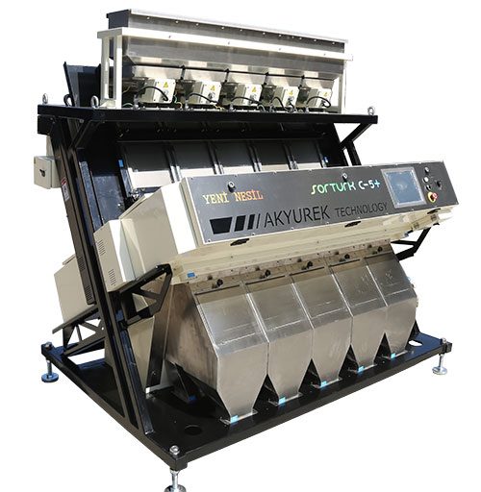
OPTICAL COLOR SORTER
Ultimate: high resolution TRICHROMATIC FULL COLOR RGB sorter with integrated shape-sizing system. Technological: image acquisition using HSI technology to see almost as a human eye.
Additional NIR cameras available (option) Precise: SORTURK ‘NEW GENERATION’ software can recognize up to 16 families
of defects. Optical resolution 0.1mm Max Capacity: highest production capacity RGB trichromatic sorter with 1 to 10 chutes models Flexible: Multichannel models divisible in 4 complete independent sections (4 sorters in 1) Reliable: thanks to over 10 years’ experience in electronic sorting Unique: with airtight, conditioned and tilting optical boxes for their easy opening

Slide 23
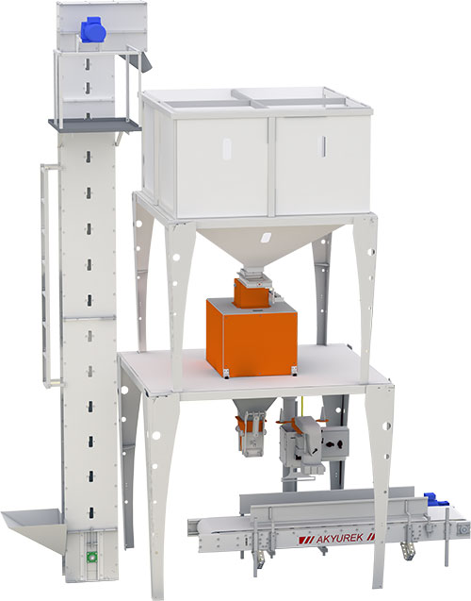
NET WEIGHER & BAGGING SCALES
Akyurek Semi-Automated Net Weigher & Bagging Scale Machines are used
for Pre-bagging weighing and Bagging of 5 to 50 kg bulk product.
Akyurek Semi-Automated Net Weigher & Bagging Scale machines are
with electronic and micro-processing control.
Feature of getting reports about sacked bags and weighing is available.
It can connect to electronic devices such as PLC or computer. Our machine can be used for all grain seeds, granule products, salt,
granule chemicals, residue, provender, cement, construction chemicals, coal and stone.
Operation starts with Operator feeding the sack to sack grip, scale weighs
the batch in two stages with gross weighing and net weighing and delivers
the seed in to sack. This process continuous in series action.
APLICATION INDUSTRY;
- Food - Cement / Construction - Chemistry / Petrochemistry - Mining
Features;
- Fast and Sensitive weighing - Programmable number of bag to ﬁll - Conﬁgurable Max and Min Limits - Warning at Out of tolerance weighing - Level Check at Top Tank - Weighing Memory

Slide 24
PENDULUM BUCKET ELEVATOR
The P- EL and Z-EL elevator is suited for transportation of cereals, seeds, fertilizers, minerals, wood shavings, wood chips, granular products, and similar materials; also suitable for oleaginous seeds.
-Bucket Elevator
-Easy Dump Elevator
-Continuous Cup Bucket Elevator
-Continuous Cup Z Elevator
-Chain Conveyor
-Tripper Conveyor Belt
-Screw Conveyor
-Pendulum Bucket Z Elevator

Slide 25
CENTRIFUGAL FAN
The Akyurek centrifugal fan type ACF is a medium pressure fan having backward
curved steel blades manufactured in steel plate. The impeller is self-cleaning and
dynamically balanced. The spiral housing is made of welded steel plate.
-Centrifugal Fan
-Blower Group
-Airlock Valve
-Jet Filters
-Cyclone Akyurek
-Modular Pipework Systems

Slide 26
CYCLONES
Akyurek Cyclonic separation is a method of removing particulates from an air without the use of ﬁlters, through vortex separation. Rotational effects and gravity used to separate mixtures of solids from air. Akyurek designs and offers most suitable model of cyclone for your needs. As f all our products stability, Functionality, Durability, Reliability applied to our Cyclones during designing processes.

Slide 27
CONVEYOR BELT
Akyurek Belt conveyor type T.BELT-014 is made up of standard elements which, when correctly combined, can easily be fitted into any conveying installation. The Akyurek Belt Conveyor is manufactured in galvanized steel and or Painted and designed in a light and easy-to-assemble modular system. Type T.BELT-014 is designed with guide rollers which is quiet and have low power consumption in relation to their capacity. There is also a possibility for transport at an upward angle of up to 30° using carriers. The Belt conveyors is well-suited to safe and eective transportation of most materials.

Slide 28
AUTOMATION & MMC
The highest capacity of Akyurek Technology equipment is achieved by automation. As a result of many years of experience we can advise the best automation level for
controlling the processes. In this respect, Akyurek Technology obvious strength is that we have gathered our knowledge of processes, systems and automation into one organization and, by choosing Akyurek Technology as an automation partner,
our customers get a properly dimensioned system based on modern technology and optimized functionality. The advantages of being a turnkey partner include design and execution, as well as subsequent servicing when the need arises.

