Slide 1
Gaily for Export Promotion

Slide 2
SUDAN SESAME SEEDS Review of Season 2020/2021
Prepared & Presented by: Mr. Mamoun Gaily
CHINA CHAMBER OF COMMERCE FOR IMPORT AND EXPORT OF FOODSTUFFS, NATIVE PRODUCE AND ANIMAL BY-PRODUCTS (CFNA)
Oct. 2021

Slide 3
Introduction
This year, the Sudanese Sesame export has been impacted by many factors which include:
Political and Economical changes
Fuel Shortages
Currency fluctuation and floating
Local price changes

Slide 4
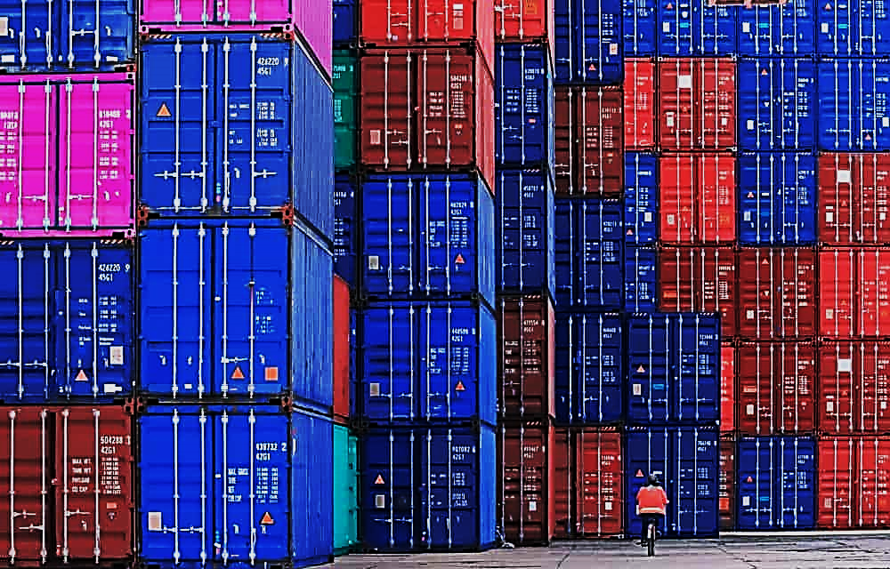
Status Of Port Sudan
Port Sudan’s port is witnessing severe decline in containers traffic due to several reasons part of which is the global containers shortage crisis, the Covid-19 pandemic in addition to the main issue of containers handling problems at Port Sudan.
Below table shows decline in number of containers handled at Port Sudan port even before the Corona Virus Pandemic in 2019.
Year | Number of Handled Containers
 | Import | Export | Total
2017 | 252,383 | 234,953 | 487,336
2018 | 229,908 | 221,804 | 451,712
SOURCE: Seaport Corporation Status – World Bank

Slide 5
Total Sesame Exports 2019-2021 (MT)
Period | 2019 (MT) | 2020 (MT) | 2021 (MT)
Jan | 71,468.70 | 85,637.46 | 36,212.24
Feb | 62,956.64 | 83,445.19 | 40,101.00
Mar | 62,275.53 | 71,420.06 | 54,781.52
April | 49,414.64 | 77,048.00 | 43,592.41
May | 49,891.01 | 44,689.64 | 38,340.55
June | 25,200.80 | 42,592.40 | 21,850.95
July | 22,054.21 | 41,432.90
Aug | 23,504.30 | 38,598.75
Sep | 25,470.16 | 50,653.32
Oct | 41,950.71 | 55,129.60
Nov | 59,888.53 | 52,297.52
Dec | 92,817.27 | 54,552.62
Total | 586,892.50 | 697,409.46 | 234,878.67
Source: Sudan Customs

Slide 6
Importers Of Sudanese Sesame During Jan-Sep 2020 (%)
Source: Central Bank of Sudan – Sudan Customs

Slide 7
Sesame Import By Major Countries – Jan-Sep 2020 Importing Countries Growth Rate Compared To Previous Season’s
Country | Export Value |  | Growth (%)
 | Jan-Sep 2020 $ (000) | Jan-Sep 2019 $ (000)
China | 221,910 | 139,044 | 59.59
Egypt | 82,674 | 84,142 | 1.75
India | 63,489 | 51,355 | 23.63
Saudi Arabia | 53,651 | 48,511 | 10.60
Turkey | 46,346 | 37,272 | 24.35
Lebanon | 23,034 | 18,633 | 23.62
Syria | 16,738 | 22,474 | 25.52
UAE | 51,570 | 20,241 | 154.78
Jordan | 19,873 | 20,097 | 1.15
Tunisia | 5,813 | 7,099 | 18.12
Greece | 7,130 | 8,933 | 20.18
Total | 592,228 | 457,801
Source: Central Bank Of Sudan – Sudan Customs

Slide 8
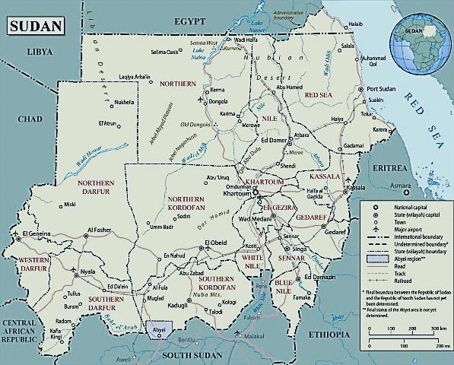
Sesame Cultivation Areas 2021/2022
[1] GEDAREF
[2] WHITE NILE
[3] KURDOFAN
[4] DARFUR
[5] SINNAR
[6] BLUE NILE
State | Crop (Fadan)
Gedaref | 750,000
White Nile | 2,050,000
Kurdofan | 3,375,900
Darfur | 1,490,600
Sinnar | 1,122,000
Blue Nile | 528,000
Others | 85,000
Total | 9,401,500
1
4
3
2
5
6

Slide 9
Sesame inflow in Gedaref Market (MT)
Month | 2019 | 2020 | 2021
January | 13,834 | 17,189 | 4,501
February | 11,944 | 12,968 | 6,701
March | 7,842 | 9,998 | 3,346
April | 4,267 | 7,016 | 1,276.40
May | 2,130 | 1,741 | 1,341.66
June | 2,074 | 4,729 | 1,134.11
July | 3,087 | 2,783 | 433.70
August | 2,003 | 2,163 | 412.58
September | 2,465 | 3,563
October | 4,000 | 3,800
November | 41,019 | 19,921
December | 24,620 | 8,808
Total | 119,285 | 94,680
Source: Gedaref Crop Market

Slide 10
Sesame inflow in Gedaref Market (MT)

Slide 11
Sudanese Sesame export to China (per MT)
Month | 2019 | 2020 | 2021
January | 25,358 | 15,788 | 34,016
February | 16,234 | 24,046 | 21,540
March | 9,247 | 19,703
April | 20,074 | 12,031
May | 14,331 | 20,988
June | 15,737 | 24,812
July | 18,178 | 37,480
August | 14,169 | 25,881
September | 11,810 | 15,469
October | 10,912 | 12,896
November | 6,320 | 9,638
December | 8,761 | 12,400
Total | 171,130 | 231,131 | 55,556
Source: China Chamber of Commerce

Slide 12
Sudanese Sesame Import in China (per MT)

Slide 13
2021/2022 Season expectation
Cultivated areas (all types): 9,635,390 fadan
Total production expected : 750,000 MT
Local Industrial Consumption 220,000 MT
Crop. caried forward : 70,000 MT

Slide 14
Thank You,
Mamoun Gaily
Gaily for Export Promotion

