Slide 1
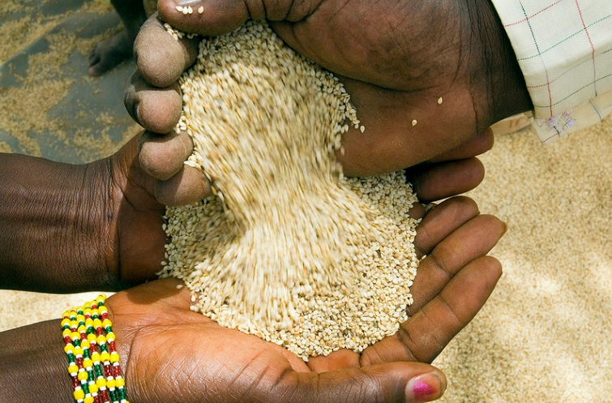
Burkina Faso and Allied Sesame Crop Outlook 2021
By: ALOK BHARGAVA
PRARAMB AGRI TRADING DMCC DUBAI.
alok@praramb.com

Slide 2
Burkina Faso and Allied Sesame Crop Outlook 2021
At the onset, I would like to congratulate sesameinfo.in and Office bearers for organizing the conference in virtual mode
I sincerely wish all the members all the best for the new season

Slide 3
Scope
Glance of 2021
West African Sesame Seed producing countries
Overall view of Burkina Faso and Allied supply position
Current Trends & Carry over Situation
Future Scenario
Disclaimer
Vote of Thanks

Slide 4
West Africa Producing Countries
WEST AFRICA
NIGERIA
NIGER
MALI
BURKINA FASO
TOGO
SENEGAL/GUINEA BISSUA

Slide 5
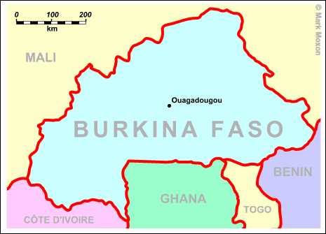
Burkina Faso and Allied
Main countries: Burkina, Mali, Togo, Senegal
Both whitish and mixed type
Main markets: China and Japan
Last year estimate: 200/210,000 MT
Burkina now Dft but still not active
Crop to start from November

Slide 6
Burkina Faso and Allied Production
Country | Season 2019/2020 | Season 2020/2021 | Expected 2021/2022
Burkina Faso and Allied | 180,000 | 200,000 | 210,000
TOTAL | 180,000 | 200,000 | 210,000

Slide 7
China Imports – Jan to Aug 2021

Slide 8
Trends and Current Stock
Burkina Faso and Allied
Season to start in November
Crop expected to be good
Harvesting reported in some area
Crop Size expected 210,000 mt
Both white and mix available
Initial asking price Indications are towards higher side 690-700 Cfa but this will change when arrival begins
Logistic issue is expected to occur
Old crop almost Finished at Origin.

Slide 9
Trends and Demand
JAPAN
Buying position of Dec/Jan
Logistics issue of Nigeria – continuing
Prices range for this year around US 1250 levels to 1570 USD Currently
Import quantity is expected at 180K for the year.
CHINA
Stock is now 210 k as compared to highest of 300 k
China showed maturity and systematic buying
Currency appreciation
Niger /Burkina replacing Ethiopia as main supplier
Import quantity remains at 800K+
TURKEY/MIDDLE EAST
Import quantity remains stable.
Buying not in large quantity due to the lockdown impact on small seed demand

Slide 10
Future Direction of Market
Future depends on buying from China
Logistics issue remain a major concern and can add fuel to market
Currency fluctuation.
Reduced buying power everywhere But Imports not much change.
Origins are firm and adamant after Corona time.

Slide 11
The contents of this presentation is based on information received from trade, unorganized sources, understanding and interpretation. It only represent observation and personal opinion and does not constitute for any business decision or to challenge any information or opinion.

Slide 12
PRARAMB NETWORK
TANZANIA
NIGERIA
MOZAMBIQUE
MALAWI
KENYA
UGANDA
BURKINA FASO
IVORY COAST
GUINEA BISSAU
RUSSIA
UAE
Emerging Re-Exporter of the year 2018

