Slide 1


Analysis of China Sesame
Production & Market Situation
CEO - Mr. Danny Chen
FLAVOR FULL FOODS INC.
Oct 26th, 2021

Slide 2
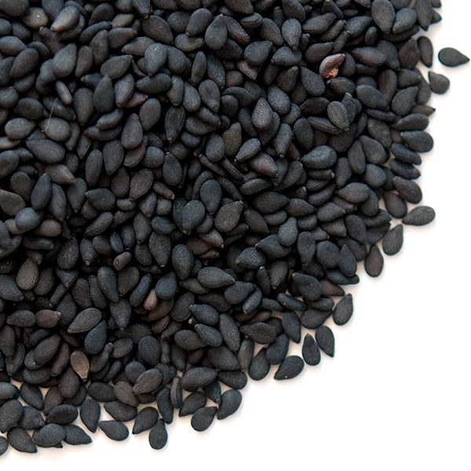

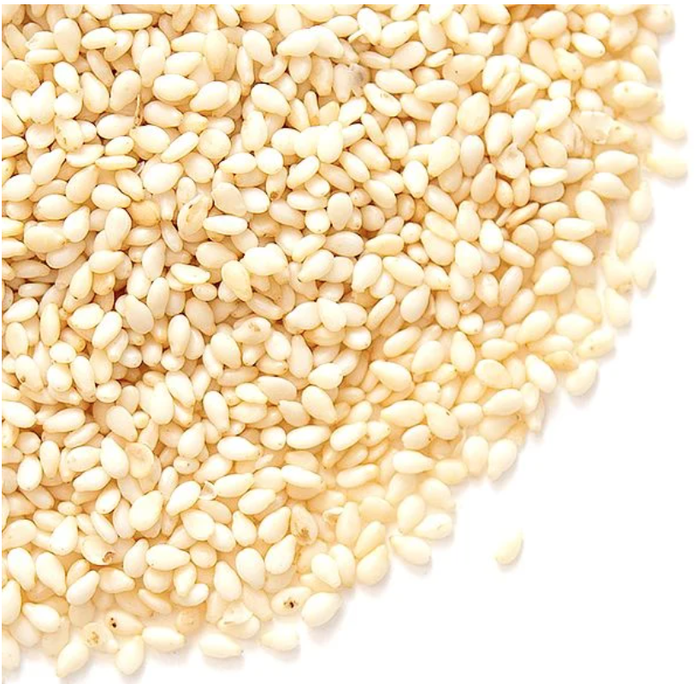
2020
Sesame crop
Review for 2020
The stages of sesame prices increasing in China’s domestic market since 2020.
From late March to early May: influenced by COVID-19 epidemic situation.
From September to October, 2020:
China sesame production was reduced more than expected, and the price of imported sesame seeds in Qingdao port and Tianjin port remained at
a low level in the past three years which stimulated the demand for stockpiling goods and the demand for substitution of imported
sesame against China sesame seeds.
®All rights reserved by FLAVOR FULL FOODS INC.
Notes:
2020 價格變動
3月下旬 – 5月上旬：COVID-19疫情之下導致價格上漲。
9 – 10月份：中國芝麻減產超預期，近三年青島港和天津港進口芝麻價格維持在低位，刺激了囤貨需求和進口芝麻替代中國芝麻的需求 種子。

Slide 3
2020
Sesame crop
Export situation
55,765 MT
46,725 MT
44,175 MT
®All rights reserved by FLAVOR FULL FOODS INC.

Slide 4
2021
Sesame crop
Growth conditions
The planting area of sesame in China decreased sharply from 400,000 hectares last year to around 120,000 hectares in 2021, which was decreased by about 70% . It is estimated that China's sesame production in 2021 will be around 125,000-150,000 tons, a sharp decrease of around 30-35% over last year. Year 2020 carry over is about 50,000 tons.
Henan
Anhui
The planting area of corn and peanut in the main sesame producing areas was increased significantly this year, and the farmers lack motivation to plant the sesame. This is the main factor for the sharp decline in white sesame planting area this year.
Hubei
Chongqing
Hunan
Jiangxi
®All rights reserved by FLAVOR FULL FOODS INC.
Notes:
中國芝麻分布以及2021概況
中國芝麻種植面積從去年的40萬公頃大幅下降到2021年的12萬公頃左右，減少了約70%。 2017年以來種植面積逐年增加的趨勢在今年結束。預計2021年中國芝麻產量在12.5萬噸左右，比上年銳減37.50%左右。
由於去年秋季以來玉米、花生等秋季作物的種植收入普遍顯著增加，今年芝麻主產區玉米、花生種植面積明顯增加，農民種芝麻的動力不足。 這是今年白芝麻種植面積銳減的主要因素。

Slide 5
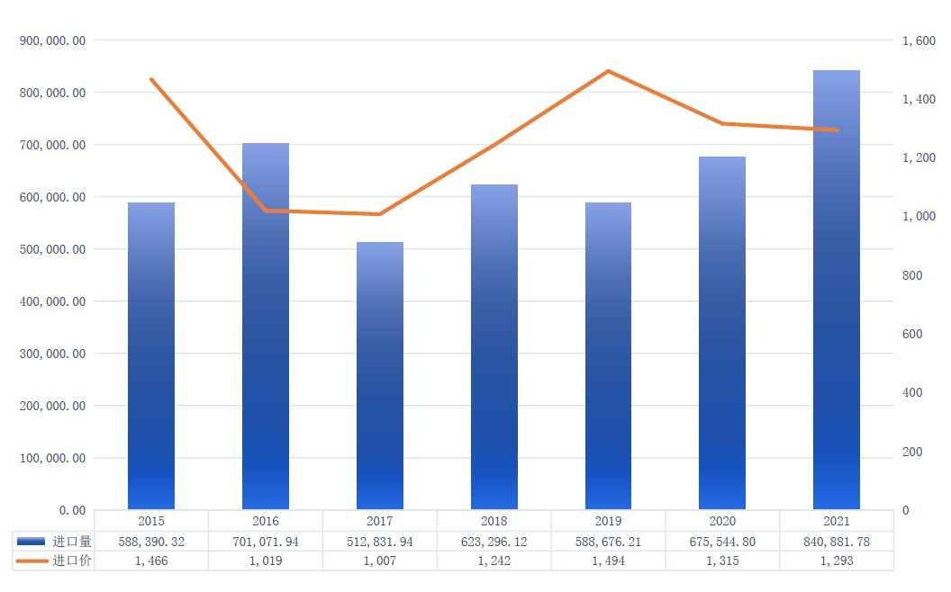

2021
Sesame crop
Import situation
2015-2021 (JAN-AUG)
Import quantity & price of China’s Sesame seeds
MT
PRICE
(USD/MT)
Qty
Price
®All rights reserved by FLAVOR FULL FOODS INC.

Slide 6

The factors which influenced
2021 Sesame seeds.
Future
External
Serious inflation, higher crude oil price and uncertain exchange rate.
Unpredictable shipping time and lack of shipping space and container.
The border of Vietnam and Myanmar were closed due to the epidemic, the imports QTY was increasing in Qingdao Port.
Covid-19 is spreading worldwide, it’s still a challenges to the market.
China power rationing and industrial production and operation cuts.
Proactive purchasing for Pakistan sesame seed, due to DFT between Pakistan and China, which covered the demand for Chinese New Year.
The shipment is delayed from Mozambique than expected before, and the shipment from Sudan port is unpredictable, how many quantity arrived in second half year will be the key factor for market.
Internal
210,000 MT stock of sesame seeds in Qingdao now.
®All rights reserved by FLAVOR FULL FOODS INC.
Notes:
內部
1.嚴重的通膨、原油高價格、以及未知的匯率變動。
2.無法預測的船運時間、缺櫃缺艙的問題。
3.新冠病毒持續影響，為市場帶來挑戰。
4.中國限電將影響產能。
外部
1.緬甸越南邊境因疫情關閉，青島港芝麻粒進口量增加。
2.現今青島港仍有21萬噸芝麻庫存。
3.由於巴基斯坦和中國之間的DFT，巴基斯坦積極採購，以滿足中國新年的需求。
4.莫桑比克的發貨比之前預計的晚了，有些貨物現在才到。 此外，蘇丹港口的出貨量不可預測，下半年進口多少將成為市場的關鍵因素。

Slide 7
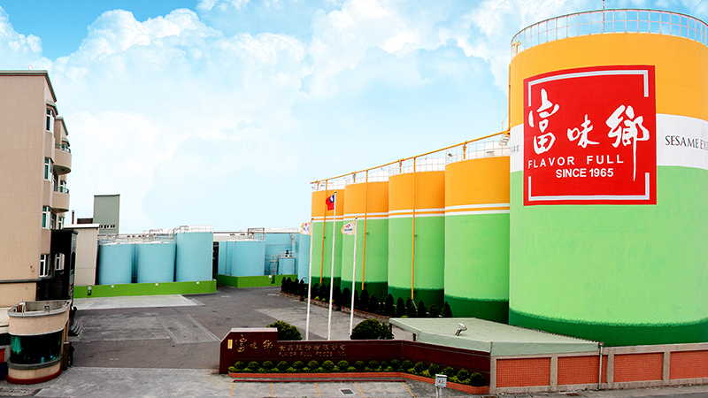

FLAOVR FULL FOODS INC.
THANK YOU
CEO – Danny Chen
danny@flavor.com.tw
http://www.forewaysesame.com
11F., No.102, Sec.4, Civic Blvd., Da’an Dist., Taipei City 106, Taiwan

