Slide 1
Egypt Sesame Market Trends
Yasser Mohamed AbouGelail
Quality Manager
Safe Herbs &Spices Co
27/10/2021

Slide 2
(iv) Sesame In Egypt
Sesamum indicum, the botanical name of the popular oil plant, has perfect features for the climatic conditions of Egypt: the plant thrives well in dry areas and needs relatively small amounts of water. Hence, sesame products are particularly important in Egypt’s cuisine. Tahina, a paste made from pure sesame is used for instance as sauce in several dishes and builds the basic ingredient in typical Egyptian creations such as hummus.
Sesame is also very liked as sweet variation. Unsurprisingly, when knowing that sesame already occurred in the Greek epoch of Egypt (4th to 1st century BC). It is even told that sesame was used in ancient Egypt. There are statements that the seeds were found in the tomb of Tutankhamun (Egyptian king from 1333 to 1323 BC). However, what is certain is that sesame was already planted in Mesopotamia around 3000 BC and has spread since then.

Slide 3
(i) Egyptian Sesame Cultivation and Types?
Sesame Cultivation in Egypt starts End of May and Harvested is in September.
Sesame seeds production increased over the years along with its demand. The range of white& brown sesame are one of the most favored crops to farmers due to its resistance to withstand unfavorable weather conditions & grow with minimum attention.

Slide 4
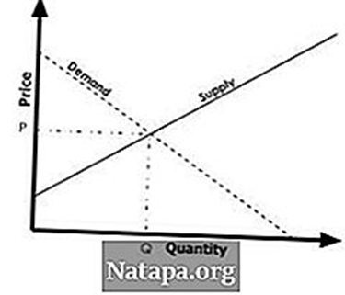
(ii) Factors that drive supply for sesame?
Supply:
-Cultivated Area : Egypt has actually 16500 ha of sesame seeds cultivation. The cultivation area is increasing from year to year.
-Weather conditions: In Egypt we have very good weather conditions for the cultivation and we are not suffering from flood and drought like in many other origins.

Slide 5
(ii) Factors that drive demand for sesame?
Demand:
-Price is the most important factor affecting the demand in the market. When the price increase, the demand decreases as the consumer always looks for the cheapest alternative.
- Quality of sesame: The consumer is always looking for a good quality and encourages the purchase of high quality products, which increases the demand for them.

Slide 6
(iii) Which origins are the major suppliers of sesame to Egyptian market?
Egyptian Origin is the Major Supplier for Sesame Market in Egypt.
Sudan Origin is also sell in the Market in Egypt because it’s cheaper than Egyptian but lower quality than Egyptian Quality.

Slide 7
What are the main sources of demand for sesame In Egypt?
The main sources of demand is the oil industry as well as the sweets industry in Egypt.
Tahina
Pastries & Sweet Pies market

Slide 8
(v) Why Egyptian Sesame?
Product Quality : we can supply a sortex quality with a purity of 99.95% .
Oil Content : Egyptian Sesame achieved the highest oil percentage compared to other origins as it’s about 40-45%.
ETO: Egyptian Sesame analysis reports for ETO shows not Detected
Pesticide : Egyptian Sesame analysis reports for Pesticide shows not Detected for organic and for conventional farming as well
Packaging : In Egypt Packaging starts from 5KG to 700KG Big Bags.
Certifications: Organic , JAS, FairTrade, ISO

Slide 9
(vi) changes in regulation for Food safety ?
The Egyptian Government now is more strict in regards to food safety as it’s planned to certify all exporting company in food and agricultural section. All companies shall be registered in white list and any company out of this list won’t be able to sell or export

Slide 10
(vii) Shipping and logistics- current status and how the industry is responding to it
The current shipment situation is still good compare with other origins.
As it takes 3 weeks to ship from Egypt to Europe and for some Europe countries like Italy it’s only one week.

Slide 11
(viii) Prices Expectations
The prices are stables as the demand for Egyptian sesame increased.
Although Egyptian Sesame prices are higher than other origin prices but if the price compared with quality we will find that it’s cheaper.

Slide 12
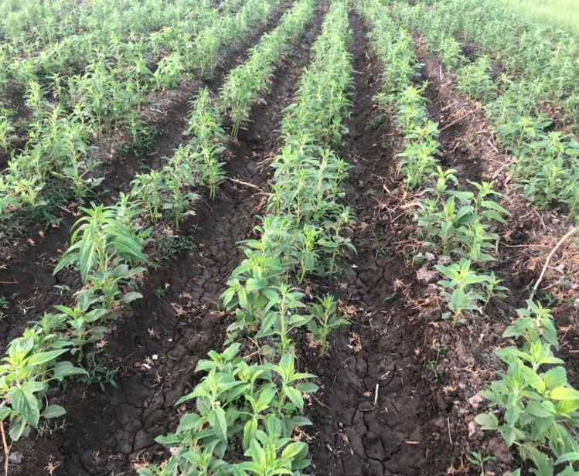
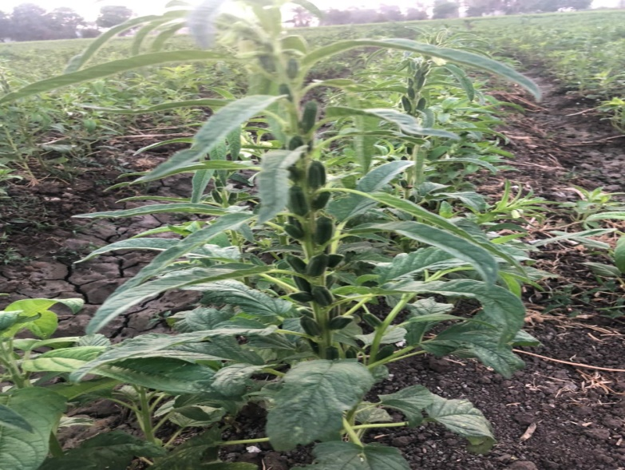
(ix) Some Photos for Egyptian Sesame
After 10 days
After 30 days
After 45 days

Slide 13
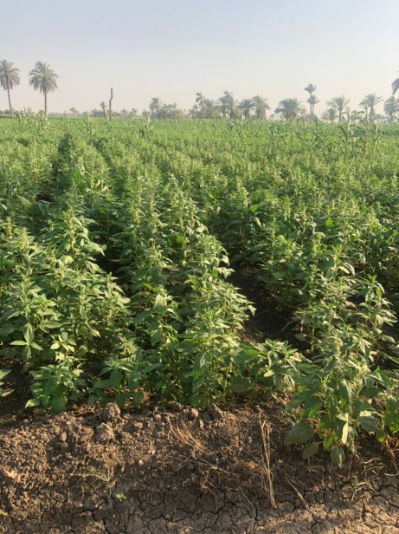
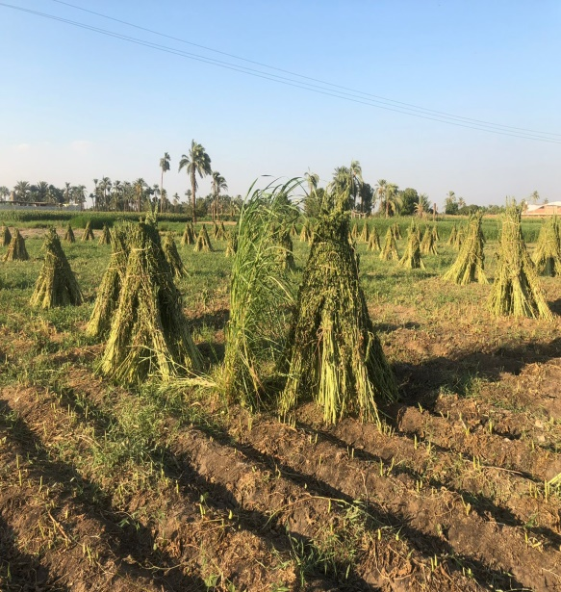
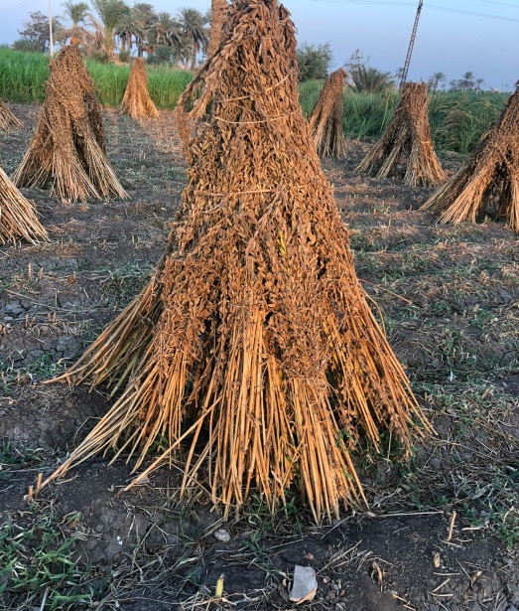
(ix) Some Photos for Egyptian Sesame
After 60 days
After 60 days
After Harvest
After Drying

Slide 14
Thank you

