Slide 1
SESAME SITUATION IN PARAGUAY
Gilberto Ozorio
President

Slide 2
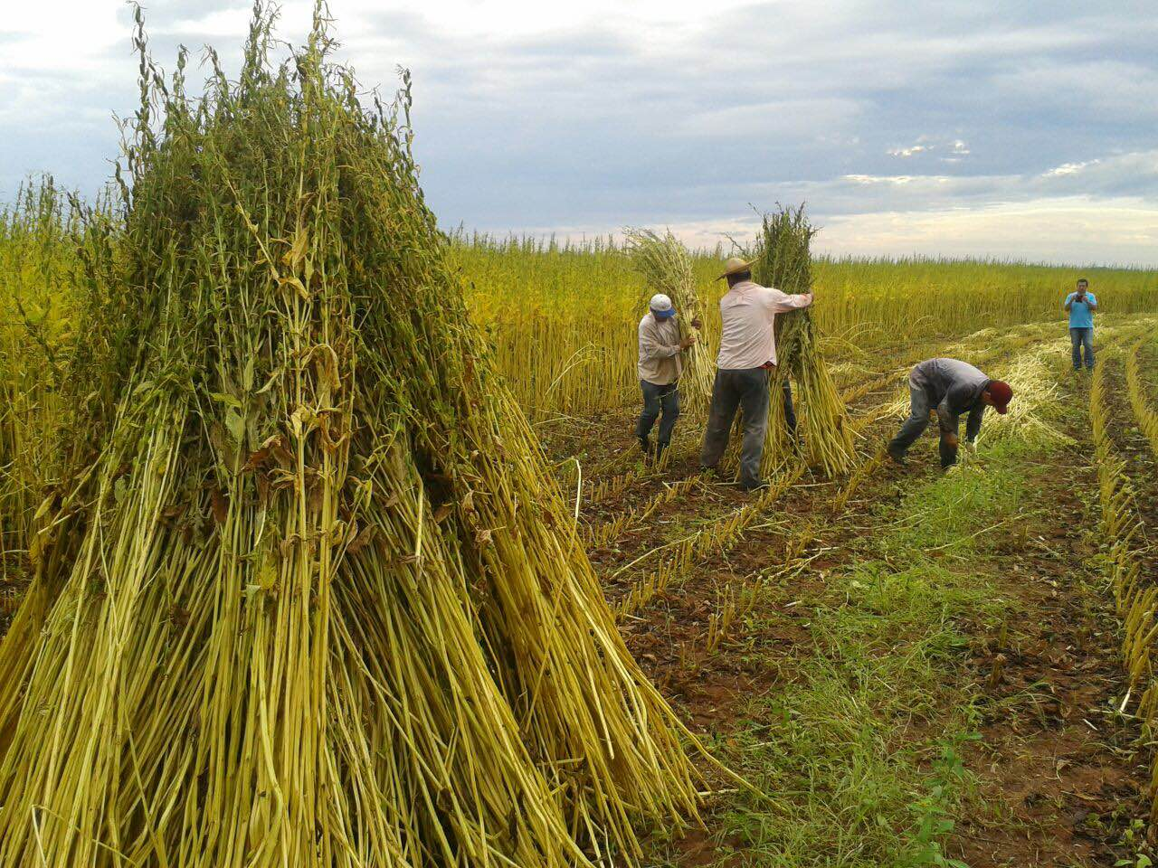
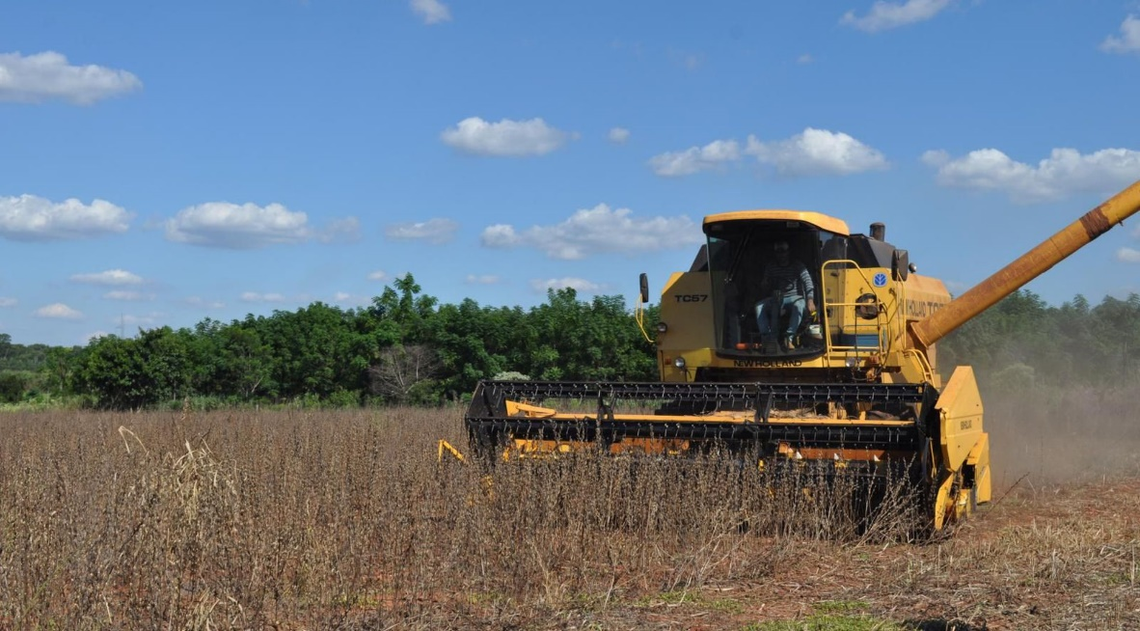
Production characteristics in Paraguay
Sesame edible grade it is produced entirely by family farming on small farms with artisanal management. 98% is produced in the eastern region of the country.
Small farms ≤ 20 hectares
Highly appreciated for taste and food safety. High social impact
Sesame industry grade it is produced entirely in the Paraguayan Chaco region. Mechanized handling in extensive properties.
Extensive farms ≥ 100 hectares
Excellent grain quality. Average FFA in last years <1%
Great potential for expansion in planting area.

Slide 3
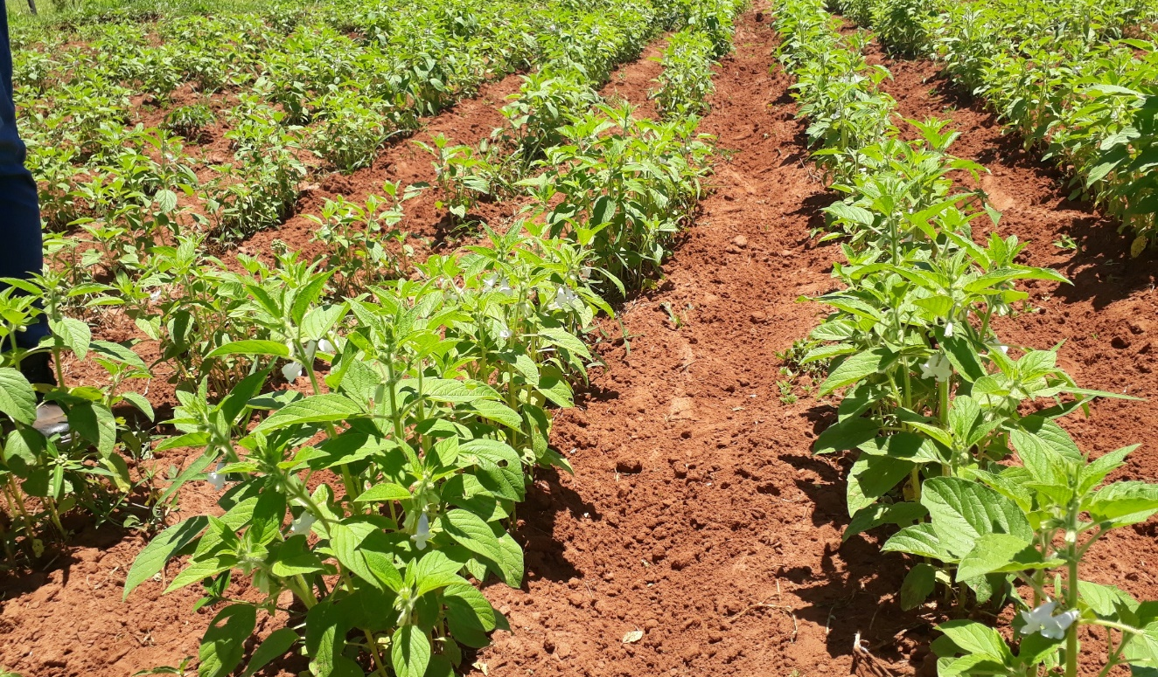
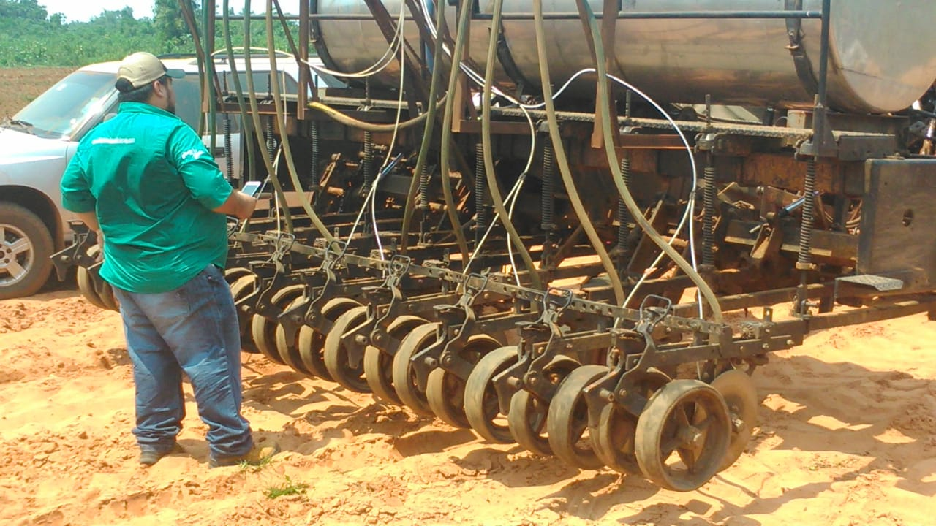
Production characteristics in Paraguay
Sowing: September – December.
Harvest: January – May
Edible varieties: K2, SH1, Escoba, Negro.
Industry varieties (Mechanized handling): F11, IP10, K3.
Yield potential: 1.200 kg/ha
Average yield: 550 – 700 kg/ha
Adverse climatic factors: Droughts, excessive rainfall.

Slide 4
Results 2020
Sowing área in 2020: 82.000 hectares
- Edible grade: 60% (White and Black)
- Industry grade: 40%
Total production 2020: 45.000 MT
Average yield: 550 kg/ha
Exports: 41.864,3 MT

Slide 5
Results 2021
Sowing área in 2021: 82.500 hectares
- Edible grade: 60% (White and Black)
- Industry grade: 40%
Total production 2021: Similar to previus year
(Collecting data)
Exports to 09/2021: 31.127,3 MT
Big increase in the quota of Europe

Slide 6
Projections
Growing trend of production and export for the next few years.
Increase in the preference of main markets for quality.
Trust of the main markets.
High diversification of destinations.
*current year with pending exports
-- Trend

Slide 7
Threats
Climatic factors every year less predictable. El Niño, La Niña
Logistical factors. World and regional for being a mediterranean country.
Other considerations
Increase in the cost of labor for the production of sesame edible grade.
Better prices should be offered to farmers.
Great expansion opportunity for sesame crop.
High investment in industry to trade hulled sesame seeds and tahini of excellent quality.

Slide 8
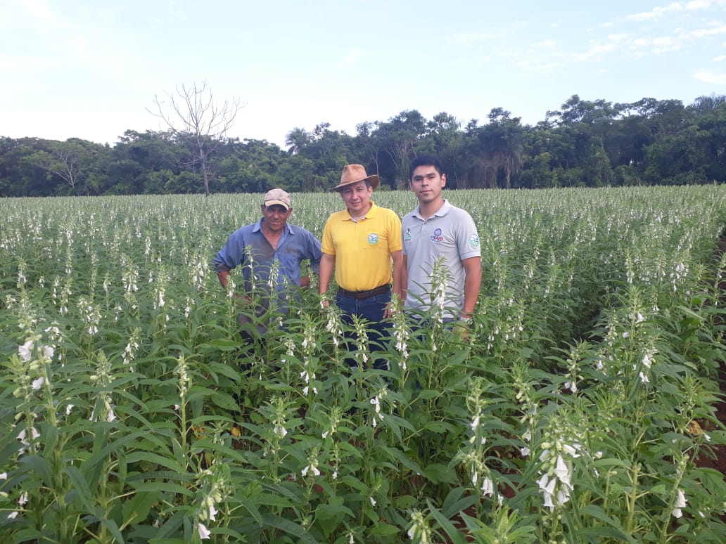
Thank you for your attention

