Slide 1
JAPAN SESAME MARKET TREND
Tomohisa Fujimoto / Team Leader
Mitsui&CO.LTD
Oct-27,2021

Slide 2
Japanese Import Quantity
(As of Aug/2021)
Overview of Japanese market
Ave,import qty is 160-170K MT annually but recently sesame demand is growing up. Especially sesame oil consumption is good. Sesame oil makes reach flavor and taste easily, that’s why home-cooking demand has going up.
The ratio of Crushing and Edible is 60%/120-130K MT - 40%/70-80K MT
Japanese market prefer stable supply
Manufacturers are managing the stock by themselves. (Trading company does not have own position)
Each edible sesame manufacturers have own preferable origin.

Slide 3
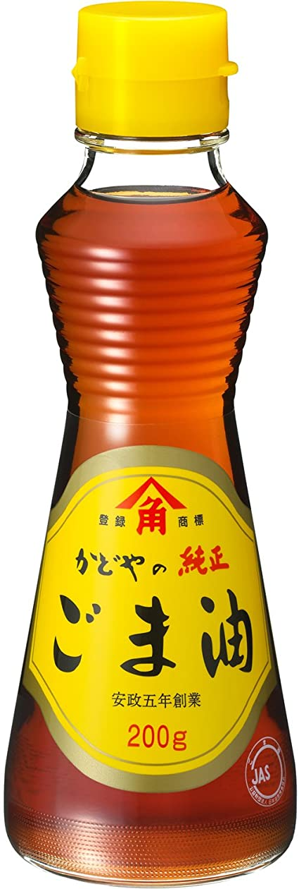
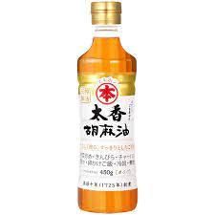
Exporter Countries to Japan (2020)
The ratio of Crushing and Edible is 60-65%/120-130K MT & 35-40%/70-80K MT
Supply Top,4 is Nigeria, Burkina Faso, Tanzania, Mozambique which is used for crushing purpose mainly.
From Paraguay, Ethiopia Myanmar and Guatemala are used for edible mainly.

Slide 4
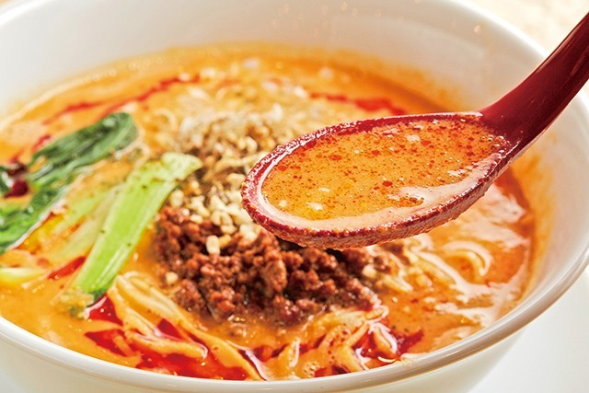
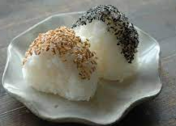
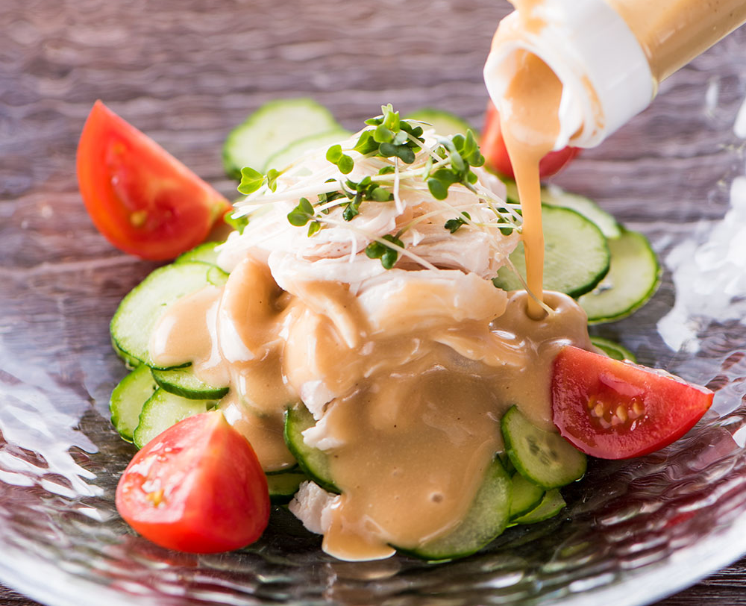
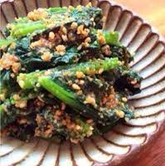
How to use in Japan
Sesame seed is typical food for Japanese.
Sesame is eaten by sesame oil, roasted sesame, ground sesame and paste(Tahini).
Sesame Oil
Retail and food manufacture
Crushing grade
Spec: Purity 98%Max, Oil 52% Min, FFA2%Max,Moisture 7% max
Sesame Meal
For Feed
Sesame Seed
Under Covid-19, HoReCa demand is decline, but home-cooking demand is increased.
* Sesame oil manufactures sales situation is good.
Roasted Sesame
Retail and food manufacture
Edible grade
Spec: Purity 99.5% More, Oil 52% Min, FFA2%Max,Moisture 7% max
Ground Sesame
Paste(Tahini)

Slide 5
Import statistics 2021, 2020
As of Aug,2021 | TOTAL | % | (JAN) | (FEB) | (MAR) | (APR) | (MAY) | (JUN) | (JUL) | (AUG)
TOTAL | 89,952 |  | 8,793 | 8,216 | 10,216 | 9,311 | 13,907 | 15,788 | 10,757 | 12,964
NIGERIA | 38,890 | 43% | 3,429 | 1,593 | 2,695 | 4,489 | 7,582 | 6,410 | 6,371 | 6,321
MOZAMBIQUE | 7,570 | 8% | 2,264 | 3,061 | 677 | 299 | 303 | 95 | 312 | 559
GUATEMALA | 7,544 | 8% | 66 | 455 | 1,054 | 1,066 | 1,811 | 2,398 | 413 | 281
PARAGUAY | 6,751 | 8% | 1,237 | 1,018 | 1,525 | 1,139 | 622 | 411 | 0 | 799
BURKINA FASO | 4,722 | 5% | 0 | 500 | 0 | 274 | 187 | 1,934 | 517 | 1,310
MALI | 2,865 | 3% | 0 | 0 | 0 | 0 | 1,578 | 794 | 493 | 0
SUDAN | 2,597 | 3% | 0 | 0 | 0 | 0 | 105 | 755 | 1,073 | 664
MYANMAR | 2,338 | 3% | 187 | 579 | 602 | 154 | 400 | 169 | 24 | 223
PAKISTAN | 2,334 | 3% | 107 | 53 | 800 | 297 | 127 | 54 | 90 | 806
SOMALIA | 1,974 | 2% | 0 | 0 | 1,081 | 303 | 0 | 411 | 179 | 0
MEXICO | 1,810 | 2% | 127 | 24 | 98 | 212 | 271 | 474 | 418 | 186
NICARAGUA | 1,713 | 2% | 206 | 114 | 568 | 465 | 205 | 155 | 0 | 0
ETHIOPIA | 1,688 | 2% | 188 | 150 | 0 | 0 | 410 | 454 | 114 | 372
EGYPT | 1,010 | 1% | 193 | 287 | 202 | 95 | 0 | 61 | 94 | 78
TANZANIA | 964 | 1% | 303 | 0 | 0 | 0 | 0 | 359 | 0 | 302
OTHER | 5,182 | 6% | 486 | 382 | 914 | 518 | 306 | 854 | 659 | 1,063
As of Aug,2021,Total import qty is 89,952MT.
As of Aug,2020, total import qty is 135,606MT.
⇒ 34% short against 2020.
2020 | TOTAL | % | (JAN) | (FEB) | (MAR) | (APR) | (MAY) | (JUN) | (JUL) | (AUG) | (SEP) | (OCT) | (NOV) | (DEC)
TOTAL | 204,864 |  | 11,330 | 14,807 | 18,080 | 16,178 | 21,400 | 23,239 | 14,895 | 15,677 | 19,581 | 20,036 | 13,875 | 15,766
NIGERIA | 76,208 | 37% | 3,436 | 4,738 | 6,277 | 8,097 | 9,647 | 10,000 | 6,613 | 6,225 | 6,712 | 6,224 | 3,763 | 4,476
BURKINA FASO | 25,925 | 13% | 0 | 0 | 2,677 | 1,137 | 4,321 | 6,280 | 3,838 | 5,137 | 1,656 | 584 | 295 | 0
TANZANIA | 18,296 | 9% | 1,178 | 1,253 | 0 | 0 | 0 | 0 | 0 | 303 | 2,368 | 6,065 | 3,024 | 4,105
MOZAMBIQUE | 15,585 | 8% | 3,132 | 4,571 | 2,587 | 451 | 739 | 0 | 35 | 100 | 209 | 918 | 742 | 2,101
PARAGUAY | 15,019 | 7% | 232 | 819 | 378 | 331 | 51 | 103 | 333 | 1,598 | 3,802 | 3,093 | 2,167 | 2,112
ETHIOPIA | 11,419 | 6% | 717 | 417 | 1,058 | 1,566 | 2,255 | 1,286 | 1,006 | 415 | 1,868 | 348 | 483 | 0
MYANMAR | 6,206 | 3% | 1,083 | 1,451 | 1,457 | 576 | 698 | 388 | 205 | 148 | 0 | 105 | 0 | 95
GUATEMALA | 6,116 | 3% | 201 | 279 | 922 | 763 | 424 | 1,810 | 378 | 764 | 104 | 252 | 129 | 90
SOMALIA | 3,850 | 2% | 0 | 0 | 0 | 305 | 503 | 522 | 693 | 0 | 946 | 0 | 334 | 547
TOGO | 3,088 | 2% | 0 | 0 | 303 | 0 | 267 | 302 | 608 | 0 | 875 | 733 | 0 | 0
MALI | 2,957 | 1% | 0 | 0 | 113 | 1,194 | 967 | 683 | 0 | 0 | 0 | 0 | 0 | 0
OTHER | 20,195 | 10% | 98 | 267 | 207 | 245 | 585 | 615 | 103 | 274 | 141 | 192 | 122 | 35

Slide 6
Trade Challenges
1
Pesticide regulation (Positive list)
Sesame seed regulation is very strict therefore Trading company and Sesame oil/edible manufactures have analyze after arrival the cargo in order to make a proof safety.
Solution
Education to farmers and local traders about correct usage of pesticides.
2
Quality Issue
POD analysis result is over spec frequently. Especially Purity is over than 98% and Oil is less than 52%.
Japanese trading company bear the cost of spec difference between fact and spec. (Standard spec is Purity 98%, Oil 52%, FFA 2%, Moisture 7%)
Solution
Under covid-19 situation, Africa side factory control is become tough but please more pay attention to quality control.
3
PP bag Issue
Under Japanese Food Sanitation Act, designed and colored PP bag may be not allowed. It is a risk of contamination for heavy metal from ink.
Plain White PP bag is preferable for Japanese market.
Solution
The safest solution is not use designed and colored PP bag.
4
Shipment Delay
Same with other market.
Most of cargo has delayed compared with 2020. that’s why 2021 import qty is less than 2020.
Solution
Understood it is uncontrollable. So please share with shipping information timely.

Slide 7
Thank you so much for your attention.

