Slide 1

Sesame Market Review and Outlook
KS Prakash (Director)
Hakan Foods DMCC, Dubai, UAE
27th October, 2021

Slide 2
Sesame History In The Middle East
Sesame the oldest oil seed in the world and in the Middle East
Crushing of Sesame in Ancient Middle East
Medical Usage of Sesame in Olden Times
Tahini a staple food in the Middle East

Slide 3
Present Usage of Sesame in the M/E
Tahini / Hummus
An Favourite Flavour- Maker
Confectionery Usage
Usage in Making Helva and Sweets

Slide 4
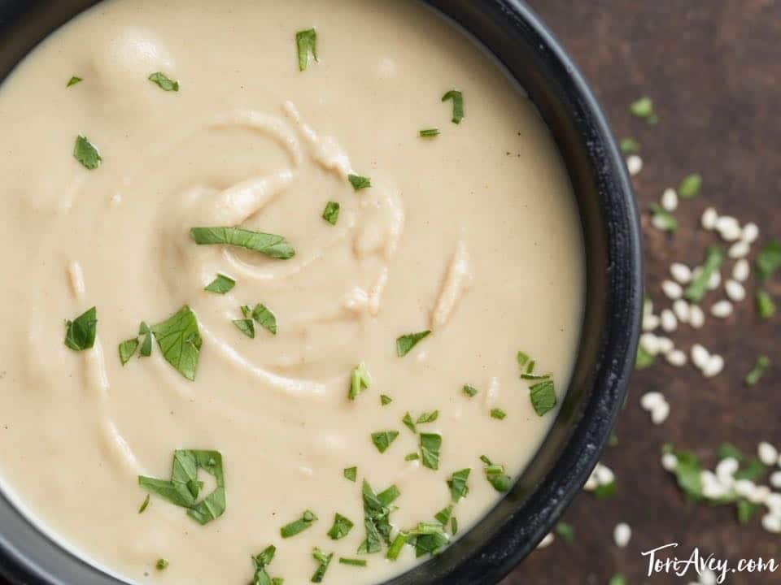
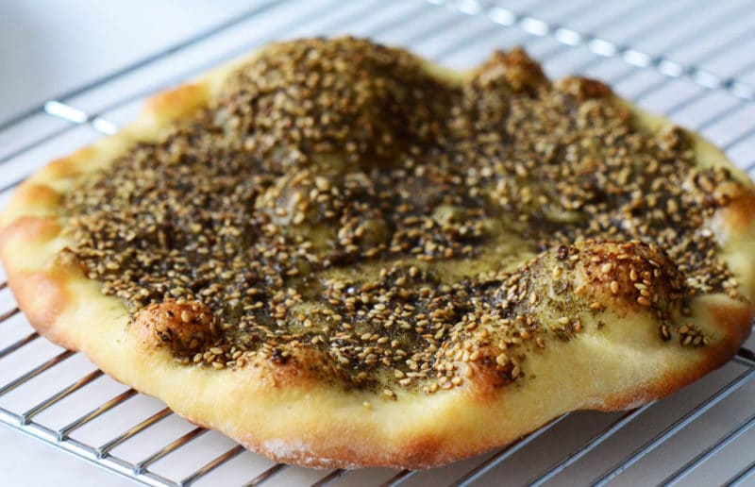
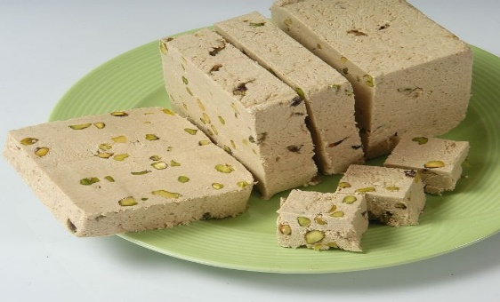
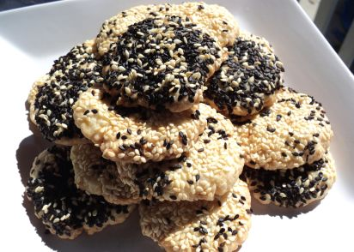
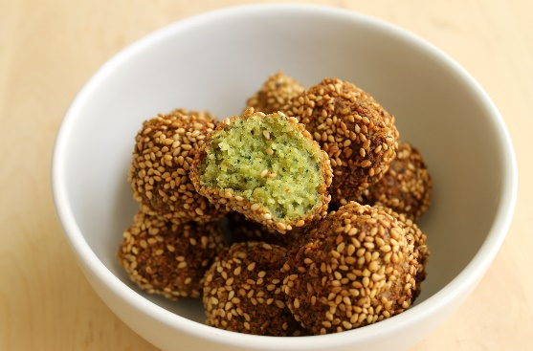
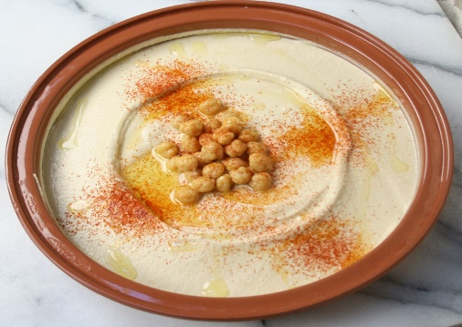
Visual View of Sesame Usage in the M/E

Slide 5
Middle East Consumption Overview
Jordan - 70,000 MT
Lebanon - 40,000 MT
Saudi Arabia - 40,000 MT
Others - 50,000 MT
Total - 200,000 MT

Slide 6
Current Difficulties in the Middle East
Political Problems in the Lebanon
Transit business stopped from Saudi Arabia to Yemen
Sanctions on Iran
Covid and related issues

Slide 7
Overview - Egypt
Local Crop – About 35/40 K MT
Import – About 70,000 MT
Main usage – Tahini and Helva
Sudan/Egypt Border Trade
Transit Business – Natural & Processed Sesame Seeds

Slide 8
Overview - Turkey
Import – About 170,000 MT
Main Usage – Tahini, Helva & Confectionery
Change of Consumption Pattern – Sudan / Tchad
Challenges of Sesame Trade in Turkey
Possibility of Hulled Export to Europe & North America
Future of Sesame Trade

Slide 9
THANK YOU,
Hakan Foods DMCC.,
Armada Tower 2, 2201,
Jumeirah Lakes Towers,
Dubai, UAE
Tel : +971 4 5831342
Email : prakash@hakanfoodsdmcc.com

Slide 10
Disclaimer
The contents in this presentation is based on the feed back received from the trade, Interpretations and various conclusions. It only represents observations and does not constitute basis for any business decision.

