Slide 1
Demand Trends in China Sesame Market
Jane Zeng
ETG Group
27th Oct’21

Slide 2
Contents
China Sesame Consumption Segment
China General Consumption Trend
Overview on Import & Export
Market Outlook
ETG World

Slide 3
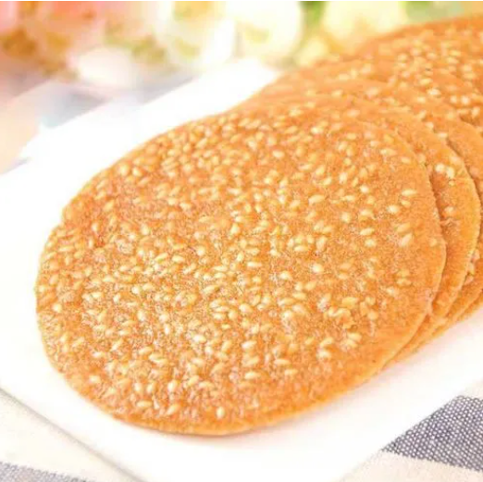
China Sesame Consumption
Segment | Share %
Crushing | 50-60%
Edible | 20-30%
Paste& Others | 10%

Slide 4
China Import & Consumption Trend
MT | Year 2009 | Year 2010 | Year 2011 | Year 2012 | Year 2013 | Year 2014 | Year 2015 | Year 2016 | Year 2017 | Year 2018 | Year 2019 | Year 2020 | Year 2021 Est
Carry In |  |  | 16,067 | 11,826 | 13,288 | 10,320 | 25,560 | 66,000 | 114,080 | 37,000 | 96,000 | 105,000 | 145,000
Local Crop | 315,000 | 450,000 | 245,000 | 331,000 | 253,000 | 215,000 | 180,000 | 152,000 | 183,000 | 250,000 | 300,000 | 150,000 | 90,000
Imports | 311,281 | 390,716 | 389,319 | 395,672 | 442,290 | 568,902 | 805,926 | 933,139 | 712,925 | 827,878 | 812,387 | 1,016,067 | 1,078,826
Exports | 34,214 | 35,384 | 35,478 | 40,110 | 37,350 | 34,517 | 26,825 | 24,014 | 35,253 | 41,679 | 50,163 | 44,175 | 45,000
Carry out |  |  | 11,826 | 13,288 | 10,320 | 25,560 | 66,000 | 114,080 | 37,000 | 96,000 | 105,000 | 145,000 | 120,000
Total Consumption | 660,495 | 876,100 | 674,038 | 765,320 | 735,608 | 803,179 | 972,311 | 1,061,072 | 1,008,258 | 1,060,557 | 1,153,549 | 1,170,242 | 1,238,826

Slide 5
Origin-Wise Import
Data source – China Customs

Slide 6
Natural Sesame & Oil Export
2020 Natural export | MT
Korea | 35,551
Germany | 3,745
Taiwan | 1,090
Japan | 1,085
Netherland | 745
Others | 1,959
Total | 44,176
2020 Oil export
Taiwan | 1,374
USA | 785
Singapore | 776
Hong Kong | 598
Russia | 401
Others | 2,991
Total | 6,926
Data source – China Customs

Slide 7
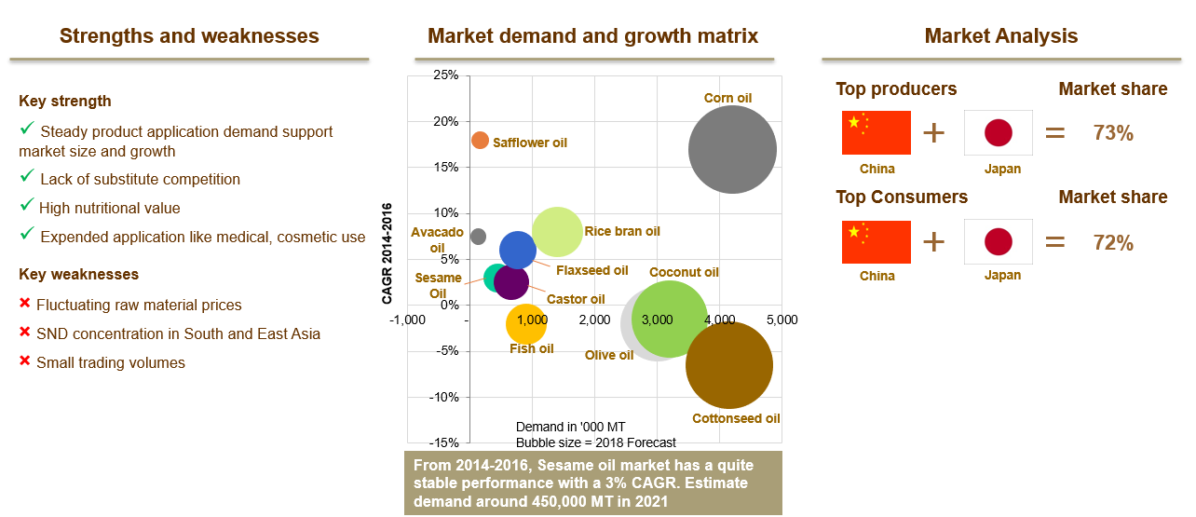
Tradition Sesame Oil Market
Sesame oil is one of the most stable market with a 3% CAGR(2014-2016) and around 450,000 MT market demand in 2018. Main market is South and East Asia. China, Japan, Korea, Taiwan have a 85%-90% market share.
Data source - KPMG oil market report, sesame market size been estimated by our knowledge of the industry.

Slide 8
Market Outlook
Tight Supply from both overseas & local side, crop shortage been reported from nearly all sesame origins
Stable demand/consumption consider the COVID situation under control quite well in China, but it can affect the economic activities anytime
Global inflation of commodity price
General supply & demand situation can result the price volatile at high level till Aug/Sep’2022 next season come.
 | 2017 1H | 2018 1H | 2019 1H | 2020 1H | 2021 1H |  | 2017 2H | 2018 2H | 2019 2H | 2020 2H | 2021 2H Est
Jan Opening Stock | 114,080 T | 37,000 T | 96,000 T | 105,000 T | 145,000 T | Jul Opening Stock | 145,500 T | 149,000 T | 170,000 T | 187,000 T | 300,000 T
Jan-Jun arrival | 422,354 T | 545,320 T | 471,225 T | 485,837 T | 680,411 T | Jul-Dec arrival | 290,571 T | 280,674 T | 341,205 T | 530,230 T | 398,415 T
June Closing Stock | 145,500 T | 149,000 T | 170,000 T | 187,000 T | 300,000 T | Dec Closing Stock | 37,000 T | 96,000 T | 105,000 T | 145,000 T | 107,944 T
Jan-June Consumption | 390,934 T | 433,320 T | 397,225 T | 403,837 T | 525,411 T | Jul-Dec Consumption | 399,071 T | 333,674 T | 406,205 T | 572,230 T | 590,471 T
Monthly Consumption | 65,156 T | 72,220 T | 66,204 T | 67,306 T | 87,568 T | Monthly Consumption | 66,512 T | 55,612 T | 67,701 T | 95,372 T | 98,412 T

Slide 9
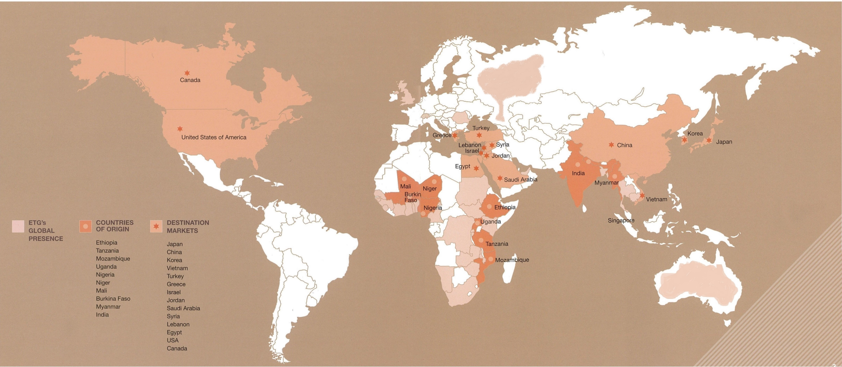
ETG World
ETG’s Sesame World collecting from Africa farm gate, processing in Africa, supplying to all destinations.
ETG’s Sesame business today is the most diversified in geography and works for value addition across the whole supply chain

Slide 10
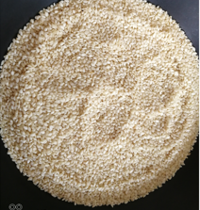
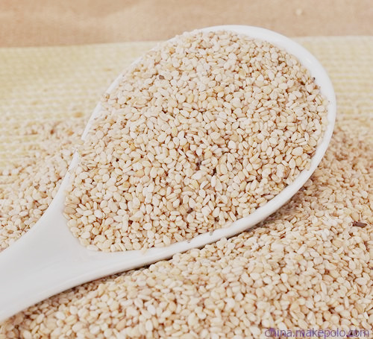
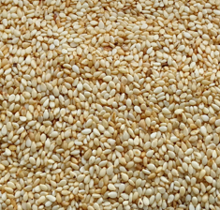
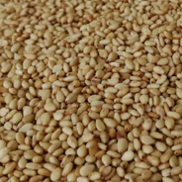
ETG in China
In 2014, ETG established ETG(Tianjin) Food Ingredients Co., ltd for sesame hulling.
First factory in China to use dry hulling technology, Yearly capacity is now about 40,000 MT
Dry-hulled sesame Seeds is now well accepted in the China market.
Established ETG Brand name in China market.
Our Products:
Dry Hulled
Edible Sorted
Roasted Hulled
Roasted Edible

Slide 11
THANKS
Jane Zeng
Mobile: +86 15653396095
Email: Jane.Zeng@etgworld.com

